Slide 1
Legal Document Processing
-Sushain Devi

Slide 2
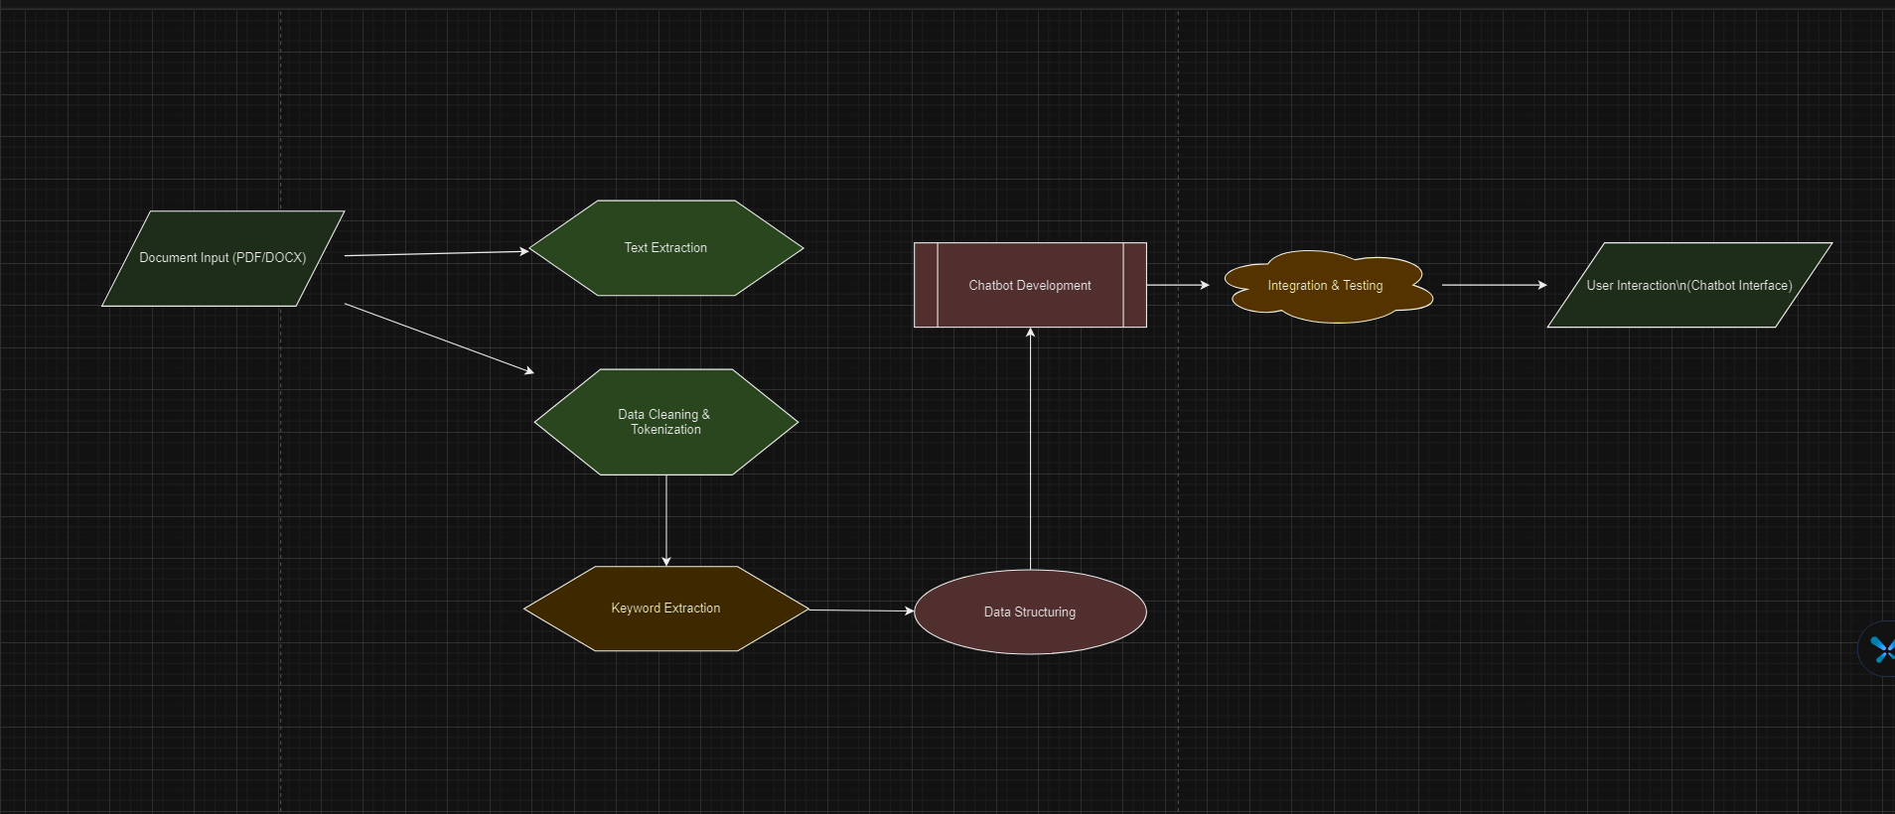
.

Slide 3
Question’s
How diverse are the legal documents typically handle like are there any specific challenges or format of the content.
Functionalities of the chat bot interface
Any specific data security or privacy considerations we need to address when handling legal documents and user interactions?

